Slide 1


Slide 2

Healthy
food

Slide 3
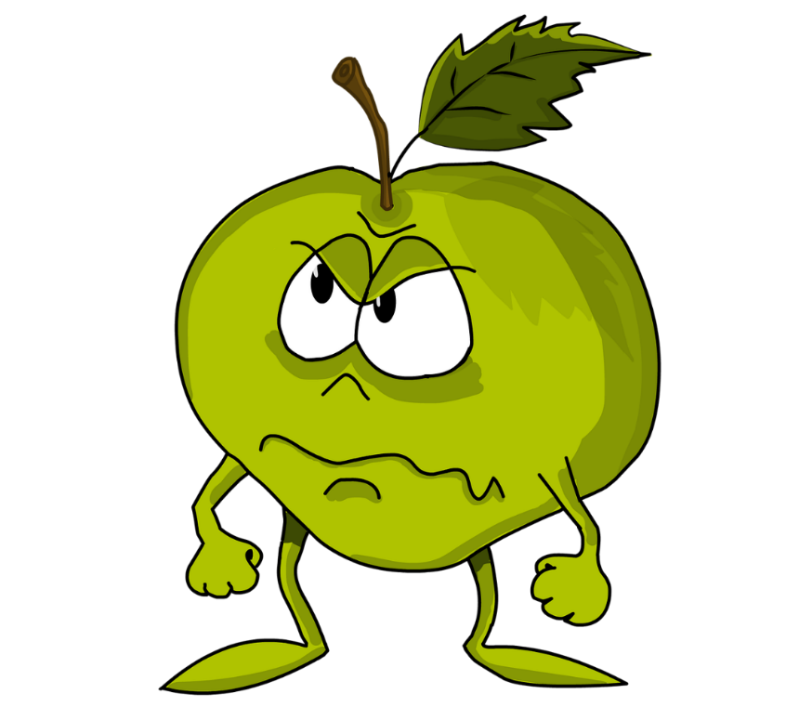
HOW CAN FOOD IMPACT
YOUR BODY & MIND?

Slide 4

IS THAT
THE NORM?

Slide 5


What your body needs mostly is…
FRUITS & VEGETABLE
NUTRITION
50 %

Slide 6

What your body needs mostly is…
FRUITS & VEGETABLE
WHOLE GRAIN
NUTRITION
50 %
30 %

Slide 7


What your body needs mostly is…
FRUITS & VEGETABLE
20 %
WHOLE GRAIN
NUTRITION
50 %
30 %
PROTEINS

Slide 8



Consuming Fruits reduce risks for diabetes
Population eating fast food mostly
Population eating fruits mostly
Person with Diabete

Slide 9


Conclusion
Good food Good health

